Slide 1
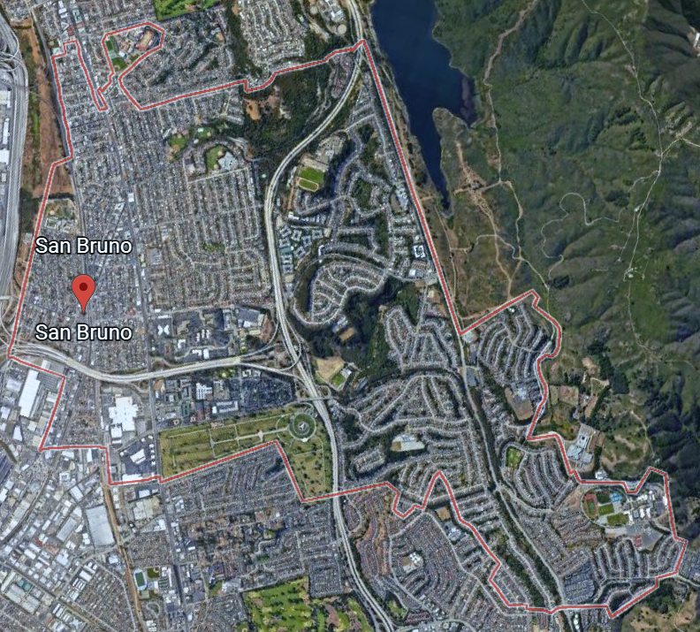
Districting Public Hearing #4
City of San Bruno

Slide 2
Presentation Overview
Background
-What is the current system?
-Why is the city making a change?
Districting Process
-What is the process for transitioning to districts?
-How does the transition impact terms/election cycles?
Outreach & Community Engagement Update
District Map Options (Council Direction Needed)
-Adopt a 4-District Map
or
-Adopt a 4-District Map and an Alternative 5-District Map
Draft 4-District Maps
-What are the legal requirements for district maps?
-Which maps are being considered?
Notes:
KRISTEN

Slide 3
I. Background
By: Kristen Parks, NDC

Slide 4
I. Background
What is the current system?
Mayor and Councilmembers are currently elected at-large
Why is the City making a change?
The California Voting Rights Act (CVRA) encourages by-district elections and makes it easier to bring lawsuits against cities with at-large elections
On March 24, 2020, the City adopted a resolution to transition to by-district elections by November 2022
San Bruno avoided an expensive legal challenge by proactively adopting a resolution to transition to by-district elections

Slide 5
II. Districting Process
By: Kristen Parks, NDC

Slide 6
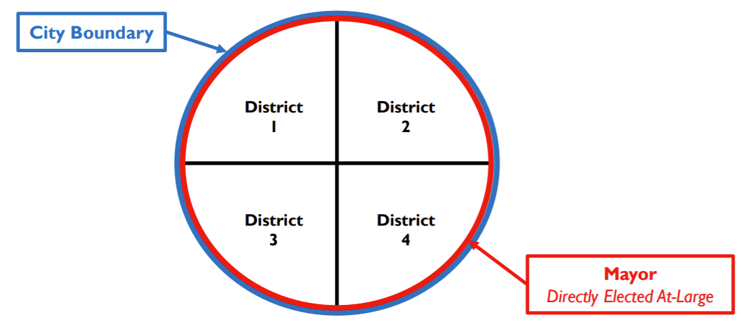
II. Districting Process
What is the process for transitioning to districts?
Council will adopt a 4-district map in 2022
San Bruno will continue to have a directly-elected mayor and a 4-member City Council*
*Voter approval required to alter this structure (Prop F, 1977)

Slide 7
Districting Timeline
Public Hearings 1 & 2 Sept. 28 and Oct. 19, 2021 | Council heard public input on the composition of districts
Community Workshops Nov. 1 and Nov. 13, 2022 | Informational presentation and demo of public mapping tools
Public Hearing 3 Jan. 25, 2022 | Council reviewed initial round of draft maps
Feb. 8, 2022 | Deadline for public map submissions for Feb. 22nd
Public Hearing 4 Feb. 22, 2022 | Council selects preferred map and may request revisions
Public Hearing 5 Mar. 8, 2022 | First reading/introduction of map ordinance
Public Hearing 6 Mar. 22, 2022 | Second reading/adoption of ordinance. Final map must be posted at least 7 days prior to adoption.
Deadline for Adoption Apr. 15, 2022 | Final date for map adoption (E-205)
County Deadline May 12, 2022 | Final date for map submission to the County Registrar of Voters
Notes:
KRISTEN

Slide 8
II. Process
How does the transition impact terms and election cycles?
No change to current Councilmembers’ current terms
All members remain at-large for the duration of their current terms—members only represent a specific district after they are elected in a by-district election in that district
Since two members are up for election in 2022 and two members are up in 2024, there must be two districts up for election in 2022 and two districts up in 2024
Council can assign any two districts to 2022, with the remaining districts then automatically assigned to 2024

Slide 9
Election Sequencing Options
 | Term ends in 2022 | Term ends in 2024
Resides in 2022 district | Runs for re-election at end of current term | In 2022, runs for district seat. If victorious, resigns at-large 2024 seat and is sworn into by-district 2022 seat for 4-year term. -- OR -- If chooses not to run in 2022, or if not victorious in 2022 by-district election, finishes current term in 2024 and leaves the Council. Can run (but not as an incumbent) in 2022. *
Resides in 2024 district | Finishes current term in 2022 and leaves the Council. Can run (but not as an incumbent) in 2024. | Runs for re-election at end of current term

Slide 10
III. Outreach & Engagement Update
By: Jennifer Nentwig, Tripepi Smith

Slide 11
City of San Bruno - District Formation
Outreach & Engagement Update
February 10, 2022
Notes:
Good evening members of the City Council
My name is Jennifer Nentwig, a Director with Tripepi Smith, the public affairs and marketing firm partnering with the City and NDC to support communications regarding Manteca’s formation of City Council Districts.
I want to thank you for the opportunity to speak with you tonight and share an update with you about the outreach and engagement efforts so far regarding this important effort.
[Next slide]

Slide 12
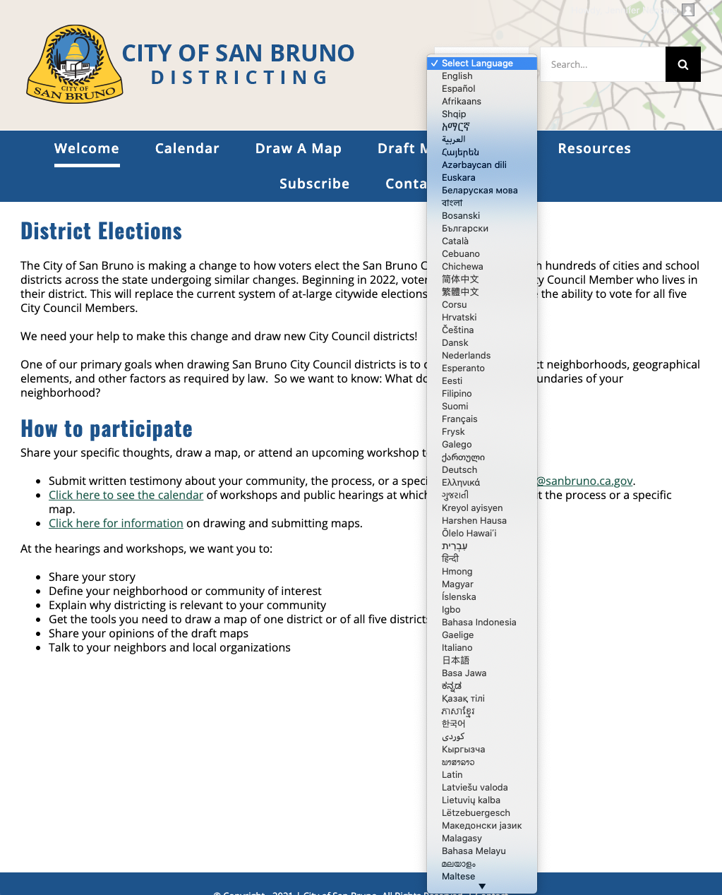
Multimedia, Multilingual Outreach
Digital
Dedicated district formation website
Emails to news alert subscribers and community-based organizations
Social media
City Manager Newsletters
CityNet “What’s Happening Around Town”
Press releases to online media outlets
Newsflash on San Bruno homepage
Continued on next slide

Slide 13
Multimedia, Multilingual Outreach
Print
Postcard mailed to all postal customers in San Bruno
Flyers
Public Notices
Press releases to print media outlets
Continued on next slide

Slide 14
Multimedia, Multilingual Outreach (cont.)
In-Person
Two community workshops (one virtual one in person)
Mall kiosk
Association meetings (Rotary Club, Lions Club, etc.)
Marquee at El Camino Real & San Mateo Ave.
City staff participation in events such as fall clean-up day, food bank events, etc.
Notes:
We have had the message on display at the marquee located on El Camino Real, near the entrance to our downtown area at San Mateo Avenue / Taylor Avenue on display for most of the month of January

Slide 15
Share Your Thoughts
Website
districtingsanbruno.org
Phone
(650) 616-7058
Email
districting@sanbruno.ca.gov

Slide 16
IV. District Map Options -Adopt a 4-District Map or -Adopt a 4-District Map and an Alternative 5-District Map
By: Jovan Grogan, City Manager

Slide 17
District Elections for the City of San Bruno
districtingsanbruno.org
Districting in San Bruno -- Two Efforts Underway Simultaneously
Establishment of City Council Districts
On March 24, 2020, the City adopted a resolution to transition to by-district elections in November 2022. As a standalone item, this will end the current system of at-large citywide elections whereby all voters elect the Mayor and four City Council Members.
The current process would be replaced with a system where all voters elect the Mayor and vote for one of 4-District Council Members.
Potential Ballot Measure to Repeal Directly Elected Mayoral Process
The City Council’s 2021-22 Strategic Initiatives included several potential ballot measures for the November 2022 election. Staff were directed conduct policy analysis and provide the City Council with options, so they could decide which items to place before San Bruno voters.
One of the potential measures is repealing the directly elected mayoral process, thereby transition to a rotational mayoral appointment process.
Notes:
City of San Bruno is making a change to how voters elect the San Bruno City Council, along with hundreds of cities and school districts across the state undergoing similar changes.

Slide 18
Mayoral Electoral Process
Measure F - San Bruno’s Mayoral Election Structure
Adopted by voters in 1977
Directly elected and at-large
Directly elected = elected separately from other seats on the City Council
At-large = No residency restriction within the City
With By-District Elections…
City may retain current electoral process for the Mayor
or
City may change the electoral process for the Mayor (requires voter approval)
Notes:
Current: The City of San Bruno is unique among cities in San Mateo County in that it also has a directly elected at-large Mayor. This method of election does not restrict where a Councilmember or Mayor resides, if they were a current San Bruno resident at the time of their campaign, and the time they held office, if elected.

Slide 19
Potential City Ballot Initiatives?
Stormwater Funding Measure?
Staff to Analyze as a Potential City Ballot Measures for Nov. 2022 Election
Commercial Prop. Transfer Tax?
City Charter?
Campaign Finance Reform?
Alternative Voting Methods?
Increase Gambling Club Table Tax?
Rotational Mayor (repeal of directly elected Mayoral Process)?
Elected Official Term Limits?
Final Council decision to placed on ballot planned for July 2022
Notes:
Final City Council decision to place items on the November 2022 ballot planned for July 2022.

Slide 20
Potential City Ballot Initiatives
Connected Items
March 29 CC Study Session
City Charter
w/ Commercial Transfer Tax
Elected Official Term Limits?
Alternative Voting Methods?
Rotational Mayor (repeal of directly elected Mayoral Process)?

Slide 21
Current City Council Electoral Process
Current City Council Electoral Process
5-person City Council with a directly elected at-large Mayor and 4 at-large Councilmembers
City Boundary
Councilmember 1
Councilmember 2
Councilmember 3
Councilmember 4
All At-Large
Mayor
Directly Elected At-Large

Slide 22
By-District Electoral Process that Retains Directly Elected At-Large Mayor
By-District Electoral Process Retaining Directly Elected At-Large Mayor
5-person City Council with a directly elected at-large Mayor and 4 Councilmembers serving distinct districts
City Boundary
District 1
District 2
District 3
District 4
Mayor
Directly Elected At-Large

Slide 23
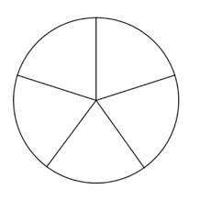
By-District Process with Rotating Mayor (no at-large district)
By-District Process with Rotating Mayor (no at-large district)
5-person City Council with 5 Councilmembers serving distinct districts without an at-large district and a rotational Mayor selection process
City Boundary
District 1
District 2
District 5
District 3
District 4
Rotational Mayor

Slide 24
Districting Options for Consideration
City Council Policy Direction Needed
Through this Districting Process, shall the City Council…
Adopt a 4-District Map
or
Adopt a 4-District Map and a 5-District Map for future use in the event the voters repeal the directly elected Mayor in November 2022

Slide 25
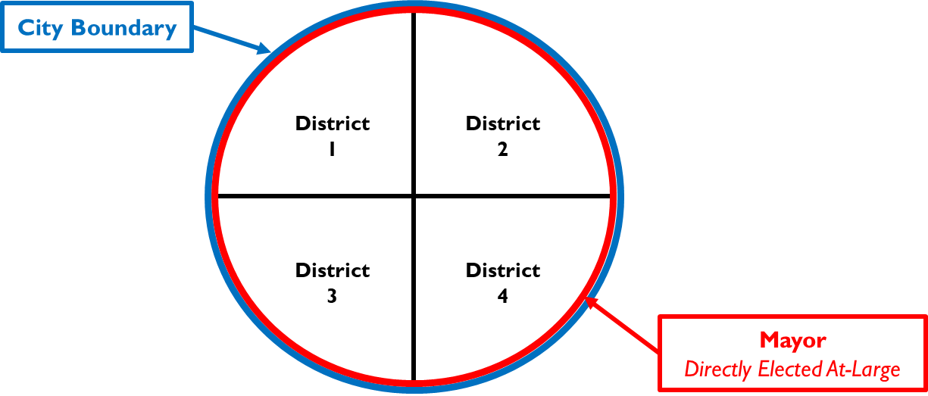
Districting Options for Consideration
Option 1: Adopt a 4-District Map
If the Repeal of the Directly Elected Mayoral Process is placed on Nov 2022 ballot and approved, the Districting Process must be redone to create 5-District Map.

Slide 26
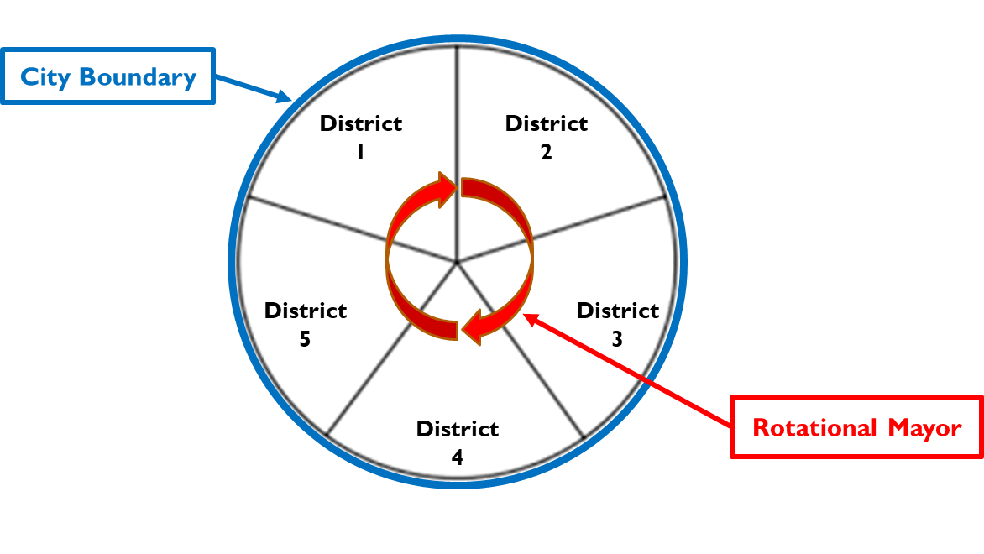
Districting Options for Consideration
Option 2: Adopting a 4-District Map and a 5-District Map for future use in the event the voters repeal the directly elected Mayor in November 2022
Creates a 5-District Map through this process, thereby eliminating the need for a new Districting Process, if a Repeal of Directly Elected Mayoral Process is placed on and adopted via the Nov 2022 Ballot
AND
Note: Staff estimates that this option may add approximately $25,000-30,000. At present, the current Districting effort is estimated to cost approx.. $100,000.

Slide 27
Schedule Impact
Proposed Schedule Modification w/ an Alternative 5-District Map
Date | Current Process 4-District Map (w/ directly elected mayor) | Amended Process 4-District Map (w/ directly elected mayor) and 5-District Map* (if directly elected mayoral process is repealed)
February 22 | Public Hearing 4 Select Preferred 4-District Map | Public Hearing 4 Select Preferred 4-District Map
March 8 | Public Hearing 5 First Reading | Public Hearing 5 Select Alternative 5-District Map
March 22 | Second Reading & Ordinance Adoption | Public Hearing 6 First Reading
April 12 |  | Second Reading & Ordinance Adoption
May 12 | Deadline to Submit to San Mateo County Registrar | Deadline to Submit to San Mateo County Registrar

Slide 28
Council Discussion and Direction
City Council Policy Direction Needed
Through this Districting Process, shall the City Council…
Adopt a 4-District Map
or
Adopt a 4-District Map and a 5-District Map for future use in the event the voters repeal the directly elected Mayor in November 2022

Slide 29
V. DRAFT 4-DISTRICT MAPS
By: Kristen Parks, NDC

Slide 30
IV. Draft Maps
What are the legal requirements for district maps?
1. Federal Law
2. California Law
Ensure equal population—total deviation < 10%
Comply with federal Voting Rights Act
Prevent racial gerrymandering
Ensure geographic contiguity
Minimize division of neighborhoods & “communities of interest”
Create easily identifiable boundaries
Maintain compactness—don’t bypass a nearby population to take in a more distant population

Slide 31
Draft Maps (32)
Public Maps: 29
Received as of February 10, 2022
Non-contiguous: 1
Not population balanced: 14
Contiguous and population balanced: 14
Consultant Maps: 3
Draft maps available online at districtingsanbruno.org

Slide 32
Contiguous & Balanced Maps (17)
Public Maps | Total Deviation | Consultant Maps | Total Deviation
Public Map 102 Public Map 103 Public Map 104 Public Map 108 Public Map 109 Public Map 110 Public Map 111 Public Map 112 Public Map 118 Public Map 121 Public Map 122 Public Map 123 Public Map 124 Public Map 129 | 8.67% 1.56% 8.88% 9.86% 4.24% 1.50% 6.47% 2.27% 7.96% 5.28% 1.98% 2.42% 9.88% 7.79% | NDC Green Map NDC Purple Map NDC Orange Map | 6.68% 6.03% 2.83%
New Submissions

Slide 33
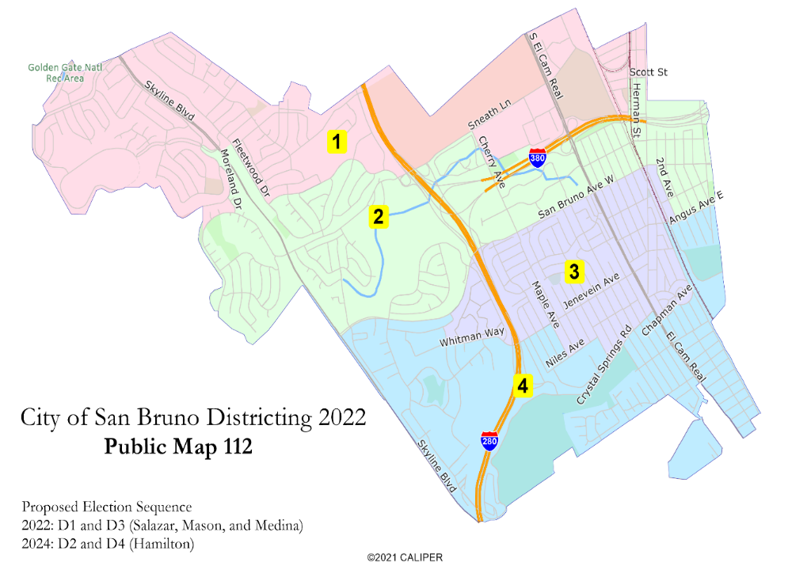
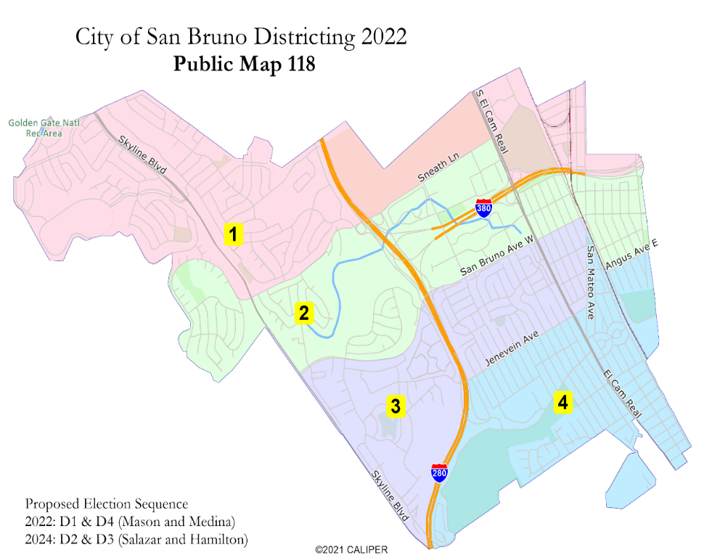
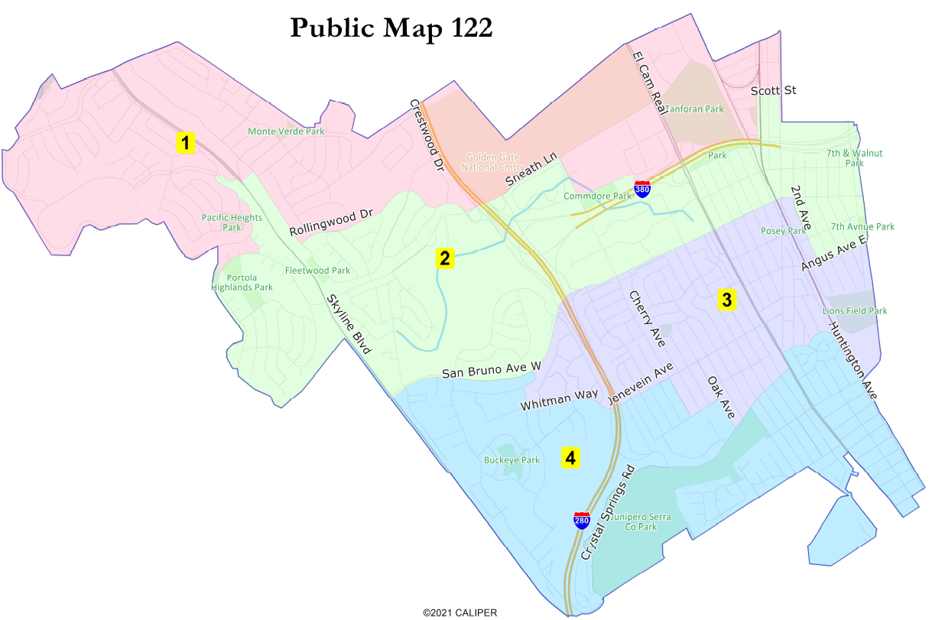
Group 1: “Layer Cake”
Concern: COIs divided
Public 112
Public 118
Public 122

Slide 34
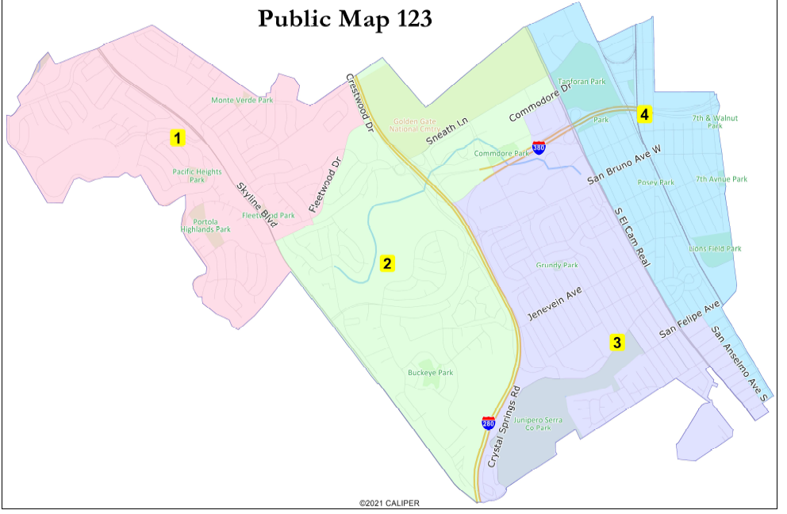
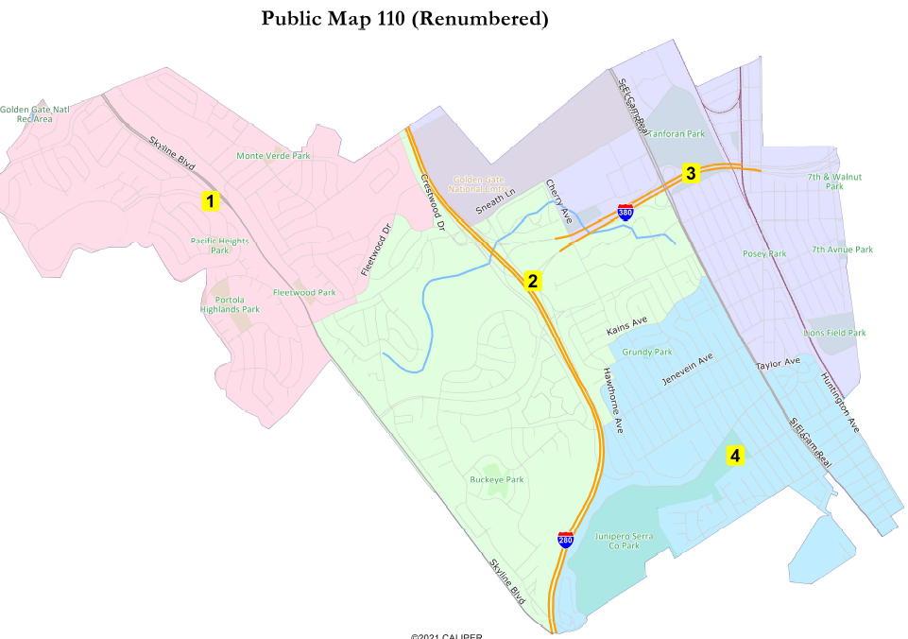
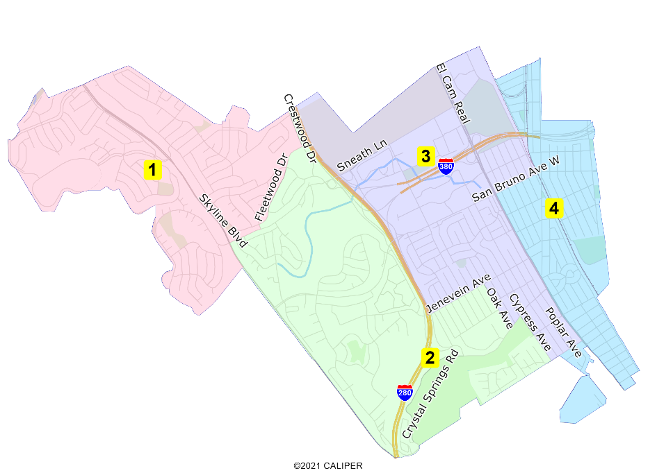
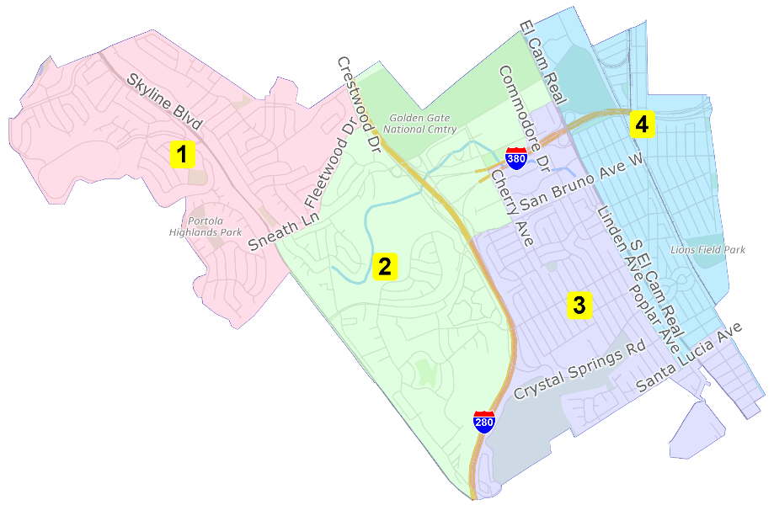
Group 2A: Rollingwood Divided
Public 123
Public 110
NDC Purple
NDC Orange

Slide 35
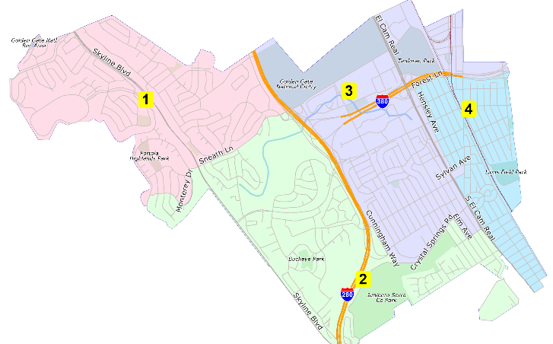
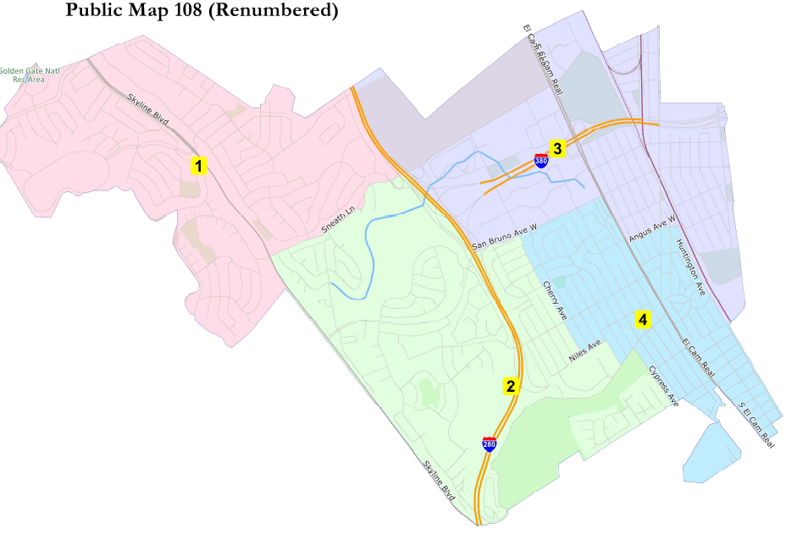
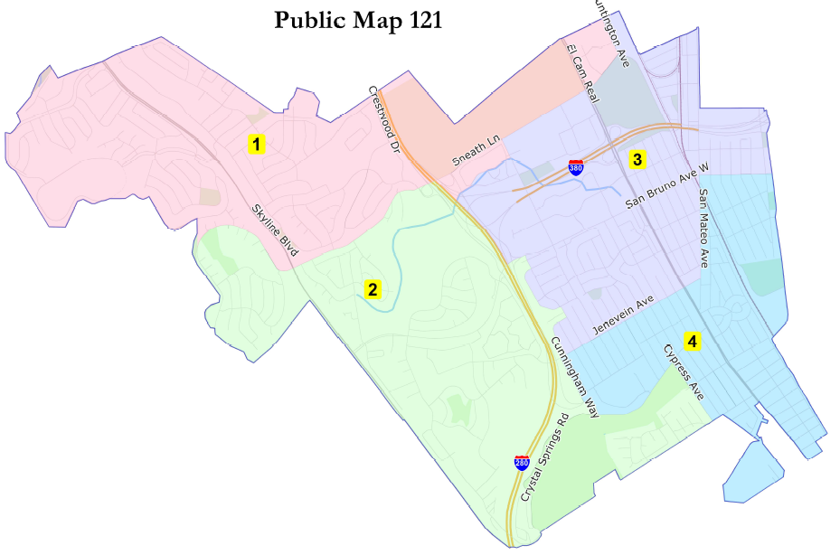
Group 2B: Eastside Divided
Public 103
Public 108
Public 121

Slide 36
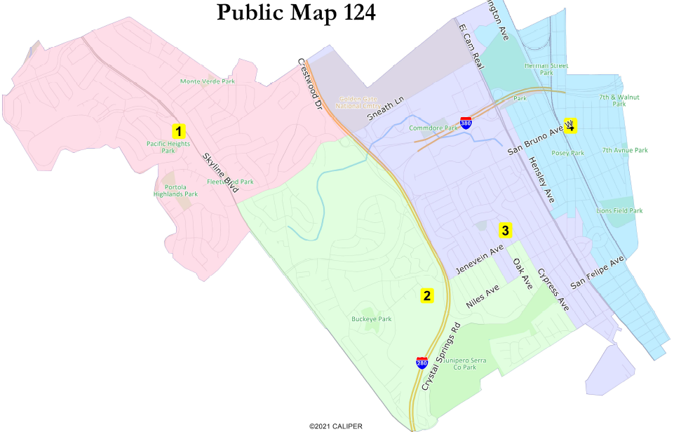
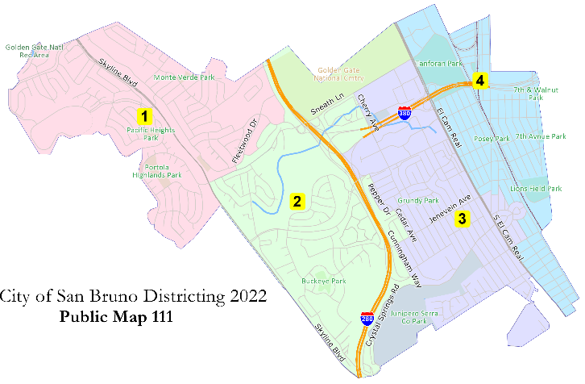
Group 2C: “Heart” Maps
Public 124
Public 111

Slide 37
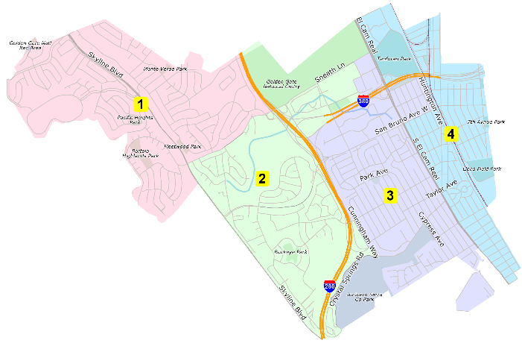
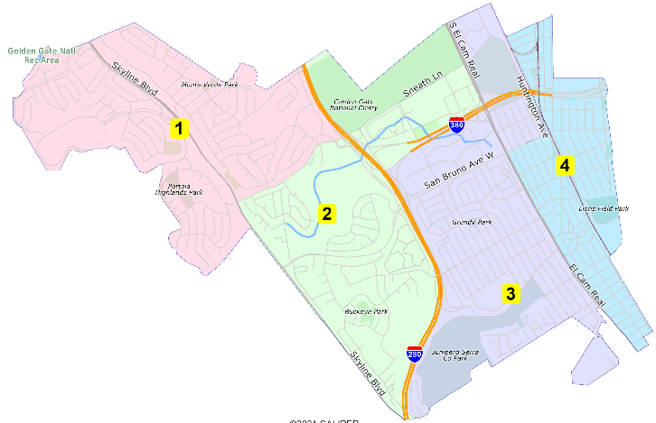
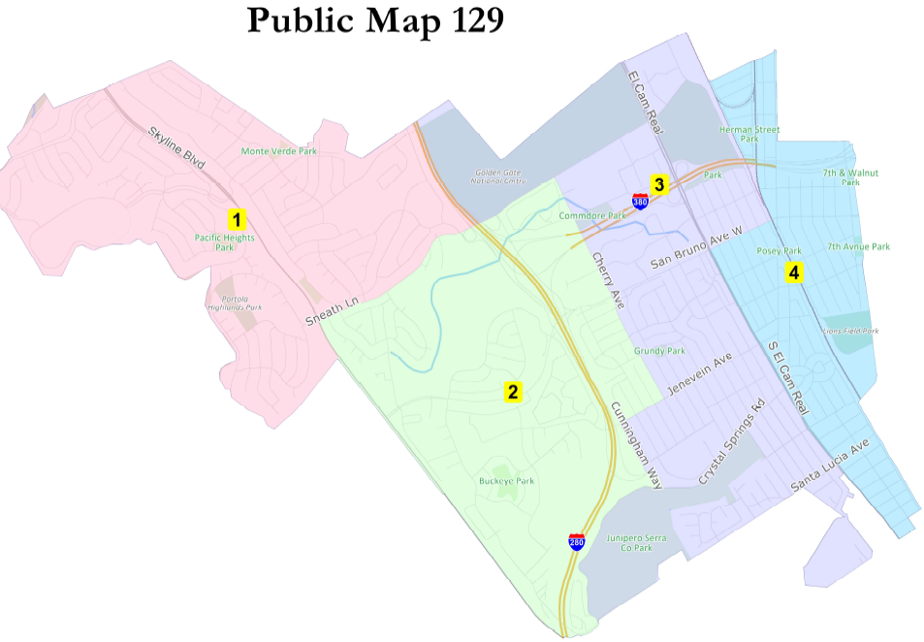
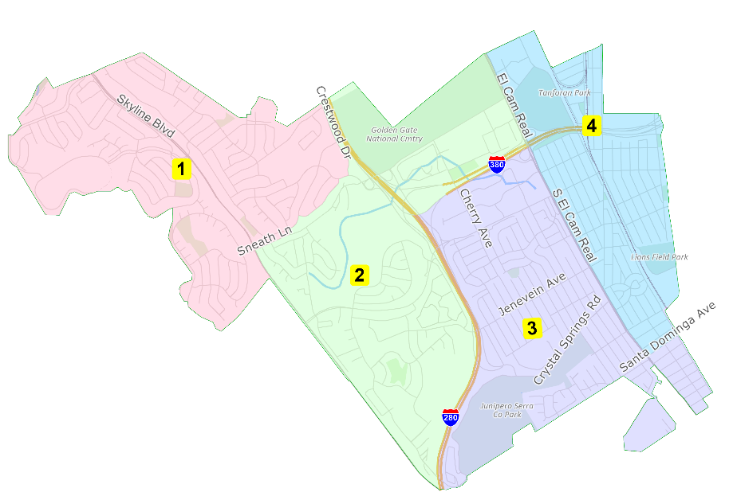
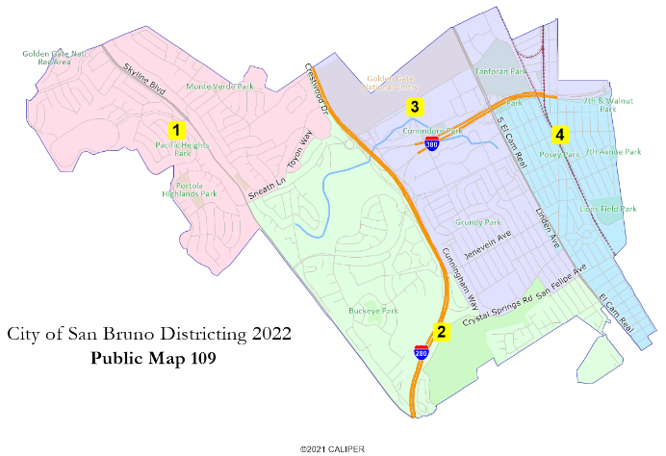
Group 3: Minimal COI Divisions
Public 102
Public 104
Public 129
Public 109
NDC Green

Slide 38
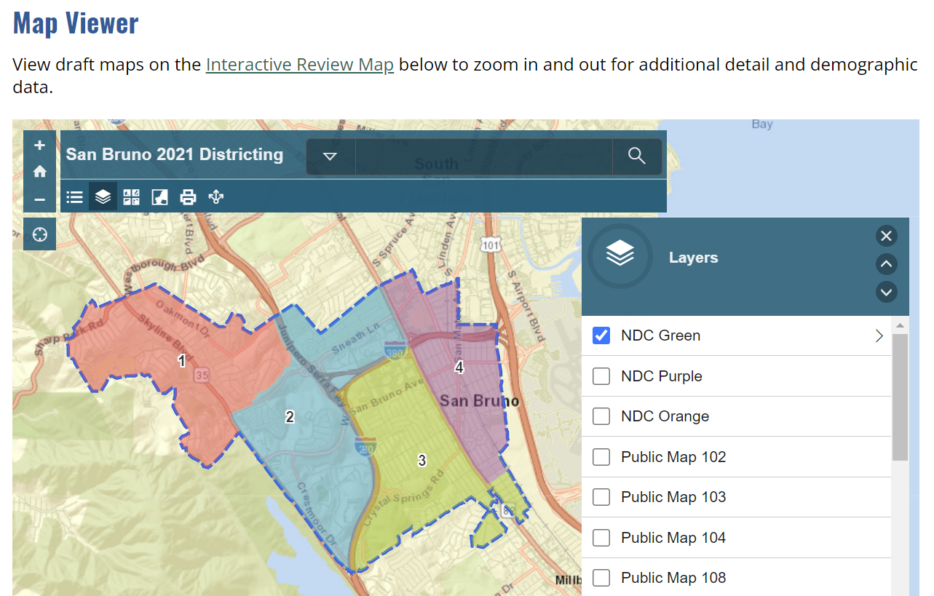
Discussion
DistrictingSanBruno.org

Slide 39
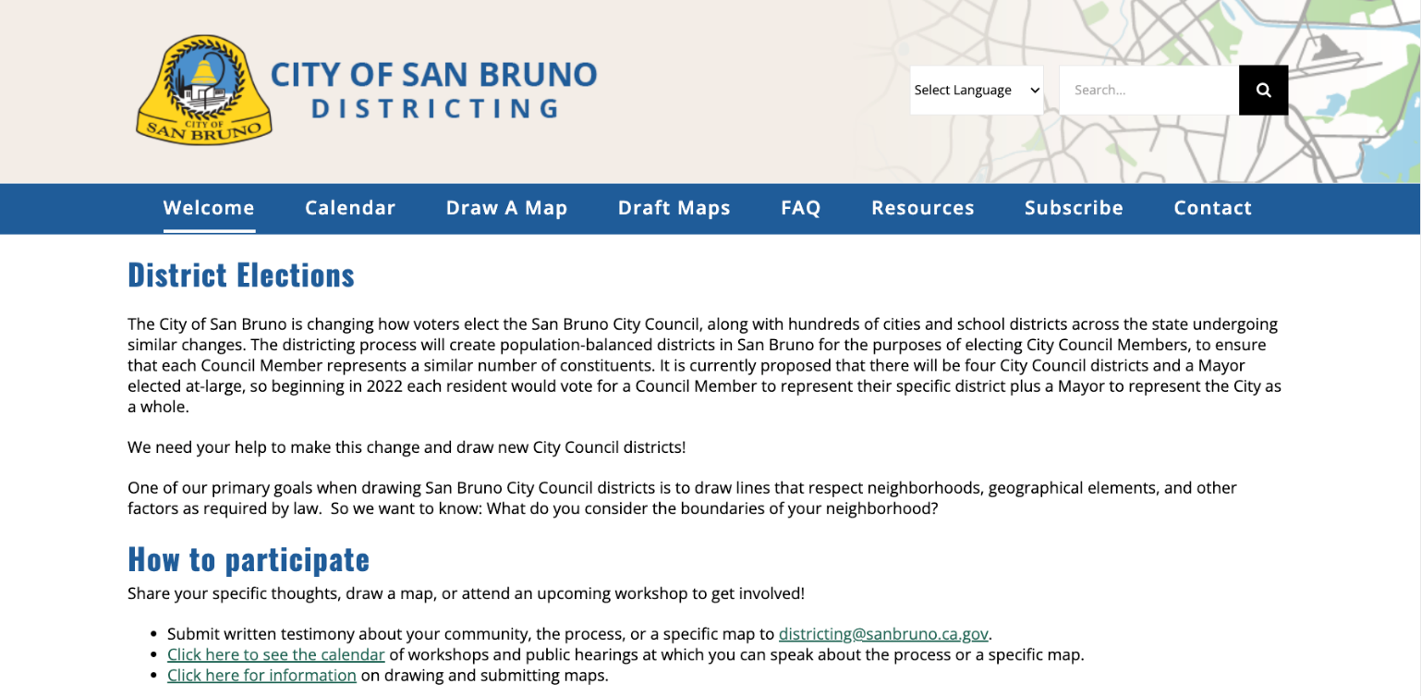
Share Your Thoughts
Click “Subscribe” on DistrictingSanBruno.org to sign up for updates
Email: districting@sanbruno.ca.gov

